Slide 1
Inheritance

Slide 2



Super Shop
Customer
---------------
ID
Name
accountType
---------------
Buy()
Manager
---------------
ID
Name
salary
---------------
BringProduct()
Employee
---------------
ID
Name
joiningDate
---------------
Cleaning()

Slide 3

Super Shop
Person
---------------
ID
Name
Customer
---------------
accountType
---------------
Buy()
Manager
---------------
salary
---------------
BringProduct()
Employee
---------------
joiningDate
---------------
Cleaning()

Slide 4
Inheritance basics
Inheritance makes it easier to create and maintain an application. This also provides an opportunity to reuse the code functionality and speeds up implementation time.

Slide 5
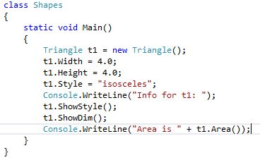
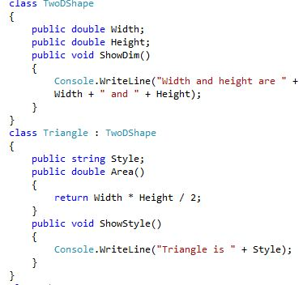

Slide 6
superclass and subclass : These terms come from Java programming. What Java calls a superclass, C# calls a base class. What Java calls a subclass, C# calls a derived class.

Slide 7
Member Access and Inheritance
A private class member will remain private to its class. It is not accessible to any code outside its class, including derived classes.
By using protected, you can create class members that are private to their class but that can still be inherited and accessed by a derived class.

Slide 8
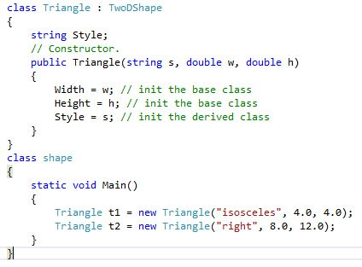
Calling derived Class Constructors

Slide 9

Calling Base Class Constructors

Slide 10
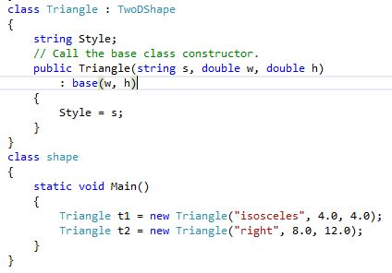
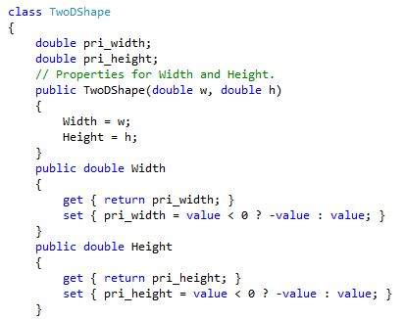

Slide 11
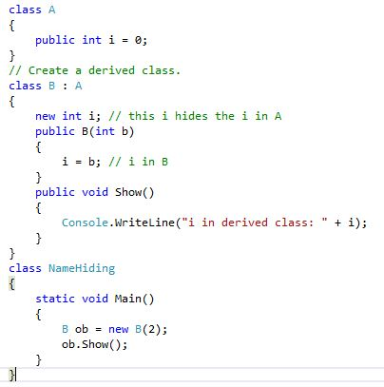
Inheritance and Name Hiding

Slide 12
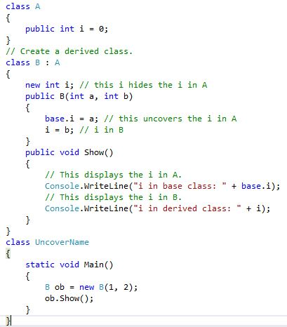
Using base to Access a Hidden Name

Slide 13
Creating a Multilevel Hierarchy

Slide 14
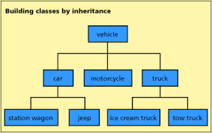

Slide 15
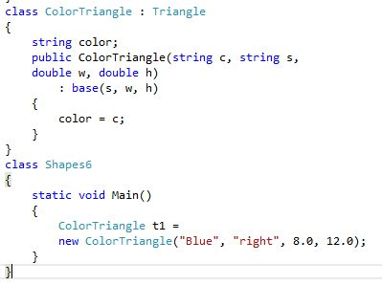
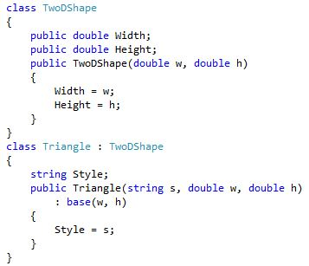

Slide 16
Mashrafy is a popular cricketer in Bangladesh. He has some wonderful records. Messi is a good football player in the world. A sports player has the following properties like name, age, country, sports name, prize money, the number of matches. Cricket player should have some additional information like runs, wicket, catch and sponsors. Football player have additional information like the number of match, goals and sponsors. Adidas and NIKE is the biggest sponsors of the world. Adidas was established in 19th century and have wealth of 10 billions. NIKE was established in 18th century and have wealth of 12 billions. NIKE is the sponsors of Mashrafy and Addidas is the sponsors of Messi.
Create class diagram from this above story using inheritance and encapsulation.
What is data-hiding technique? Why data-hiding is needed?
What is reusability of code? How can we ensure maximum code reusability?

